Slide 1
Microprocessor

Slide 2
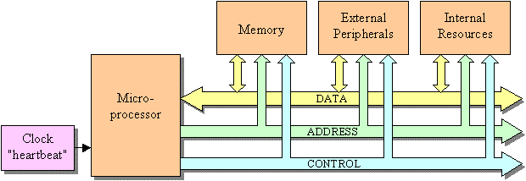
A microprocessor is a hardware component that performs three main tasks for the computer system:
Data transfer between itself and the memory or I/O systems.
Simple arithmetic and logic operations.
Program flow via simple decisions.
Although these are simple tasks, it is through them that the microprocessor performs virtually any series of operations or tasks.

Slide 3
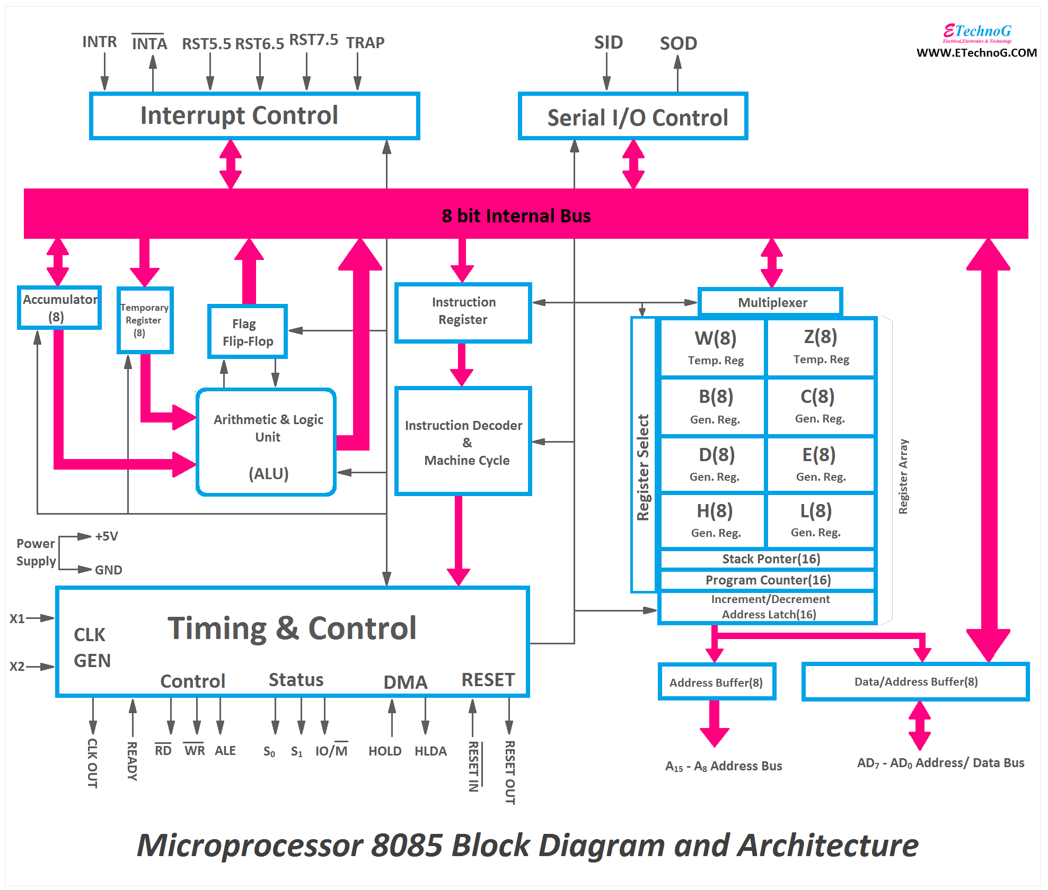

Slide 4
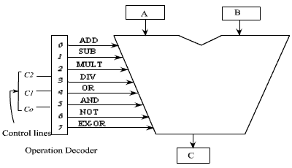
Inside ALU

Slide 5
